Slide 1

Design and Implementation of a Hotel Management Network Using Cisco Packet Tracer
Team Members –
Hari Babu Hasini - AM.EN.U4ECE22122
N Harshitha - AM.EN.U4ECE22123
Teena S - AM.EN.U4ECE22144
Maddu Siri Varshini - AM.EN.U4ECE22150
M Kanimozhi Harshini - AM.EN.U4ECE22157

Slide 2
Introduction
Hotels today depend on robust and secure network infrastructure to manage operations across departments and provide guest services. A structured, scalable, and segmented network is essential to ensure reliability and control. Cisco Packet Tracer is used to simulate, configure, and validate the network architecture.
Digital Infrastructure :
Hotels rely on digital networks for daily operations.
Secure Traffic :
Network must support guest and departmental traffic securely.
Inter-Floor Communication :
Communication and traffic segmentation are essential.
Real-World Simulation :
This project simulates a real-world hotel network.

Slide 3





Project Objectives
Network Segmentation
Segment network using VLANs per department.
Inter-VLAN Routing
Enable routing using router-on-a-stick.
Core Services
Implement DHCP, DNS, FTP, Web, Mail.
System Security
Secure with SSH and ACLs.

Slide 4
Key Features of the Designed Hotel Network
Hierarchical network structure with Access, Distribution, and Core layers.
VLAN segmentation per department for secure and isolated traffic.
Router-on-a-stick configuration using sub-interfaces enables inter-VLAN communication.
Open Shortest Path First routing, OSPF protocol ensures dynamic, loop-free, and scalable routing between routers.
Dynamic Host Configuration Protocol , DHCP provides automatic IP addressing for each VLAN.
Central servers host services like Domain Name System (DNS) , File Transfer Protocol (FTP), Web, and Mail.
Secure Shell, SSH protocol allows secure remote access to all routers.
Access Control Lists , ACLs restrict guest VLAN access to sensitive areas.
Ping and simulation confirm successful connectivity.
Design supports future Wi-Fi, IoT, and Simple Network Management Protocol (SNMP)-based monitoring enhancements.

Slide 5



System Architecture
A three-layer hierarchical design was adopted to organize the hotel network logically. This architecture provides scalability, easier management, and functional separation.
Core Layer
1
Central router links to servers (DHCP, DNS, etc.).
Distribution Layer
2
Routers perform inter-VLAN routing.
Access Layer
3
PCs, printers connected to switches.
OSPF protocol enables dynamic routing between all routers.
Layered structure enhances scalability, security, and troubleshooting efficiency.

Slide 6
VLAN Layout per Floor
To ensure logical traffic separation, each department across the three hotel floors was assigned a specific VLAN. This approach improves security and simplifies traffic management.
Floor 1
Floor 2
Floor 3
VLAN 60 (Logistics)
VLAN 30 (HR)
VLAN 10 (IT)
VLAN 70 (Store)
VLAN 40 (Sales)
VLAN 20 (Admin)
VLAN 80 (Reception)
VLAN 50 (Finance)
Each VLAN is isolated for security and bandwidth control.

Slide 7
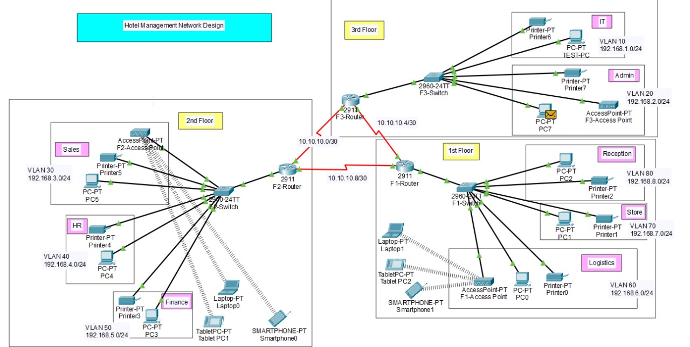
Network Topology Diagram

Slide 8
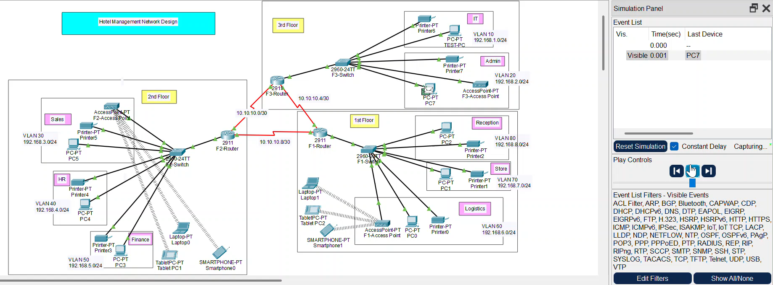
Packet Transmission
Packet successfully sent from PC7 to PC5 and acknowledgement is sent back to PC7.

Slide 9

Configuration Summary
VLANs & Trunks
OSPF & DHCP
VLANs created and assigned to switch ports. Trunk links enabled for router-on-a-stick routing.
OSPF configured for communication between routers. DHCP pools assigned to each VLAN.
Security
ACLs block unauthorized access. SSH enables secure router logins.

Slide 10
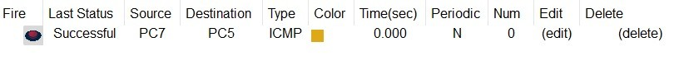
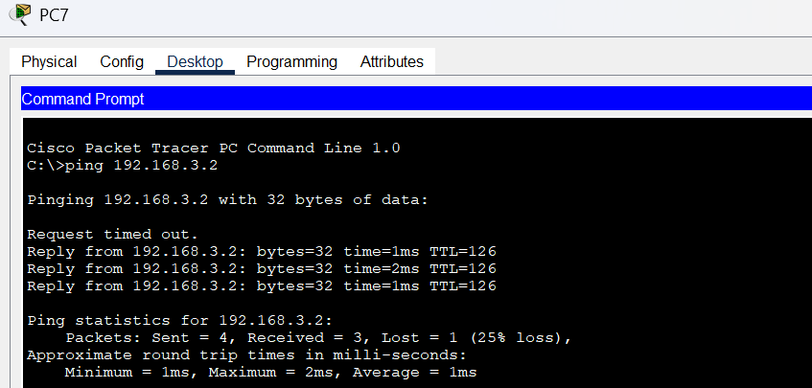
Ping Test and ICMP Acknowledgement
Packet Success
ICMP packet sent from PC7 (IT) to PC5 (Sales).
Ping Result
Acknowledged via inter-VLAN routing.
Ping Replies
3 out of 4 ping replies successful.
These tests confirm working OSPF and routing setup.

Slide 11
Conclusion and Future Enhancements
1
2
3
Secure Network
VLANs & Services
Security Enforced
Secure and scalable hotel network simulated.
VLANs segmented departments, services operated correctly.
Security enforced through ACLs and SSH.
Future enhancements include Wi-Fi, IoT integration, and real hardware testing.

Slide 12
THANK YOU

